Slide 1
DeZoZoo Phytoplankton and Micxrozooplankton
Chlorophyll a profiles (complete, not shown)
Microplankton Profiles (biomass of microphytoplankton and microzooplankton)
Copepod (Acartia) grazing on phytoplankton (chl a.) and on microzooplankton (microscopy) (with Roman, Elliot, Gutierrez)

Slide 2
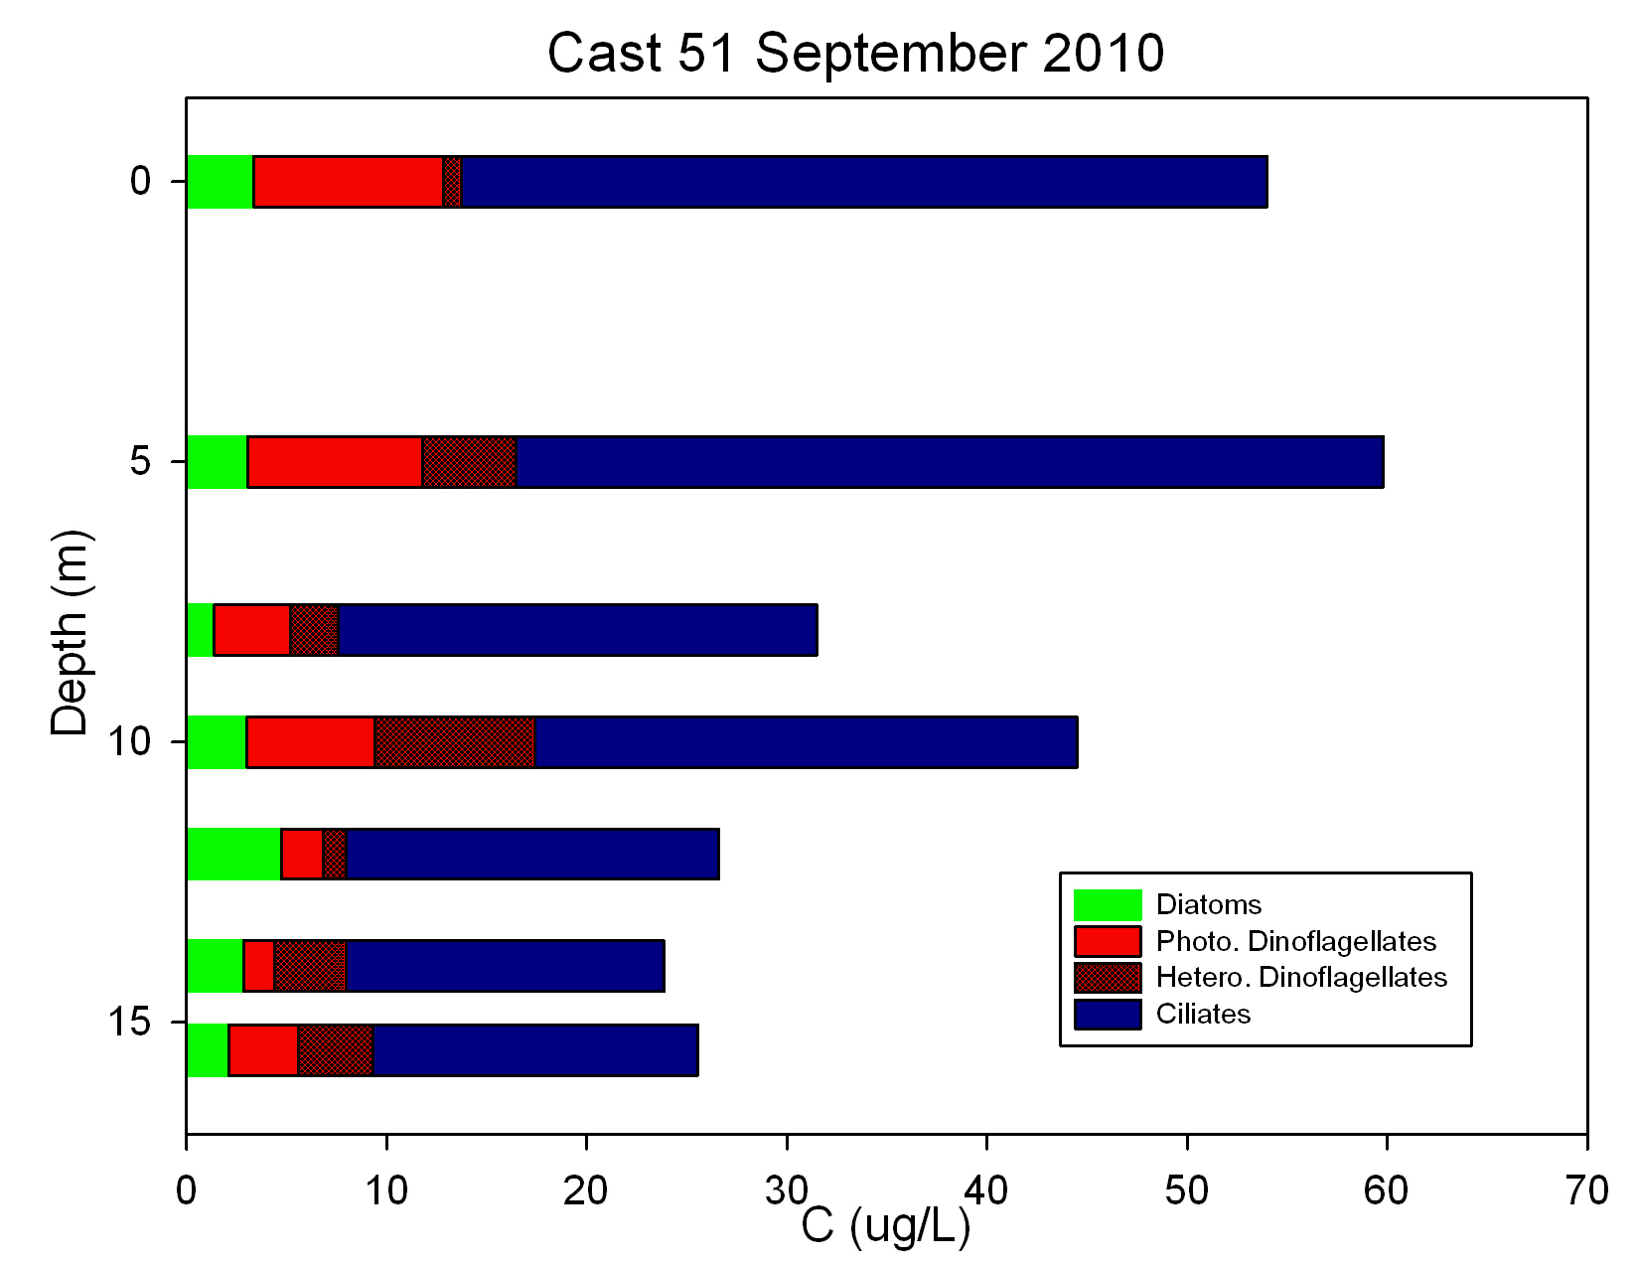
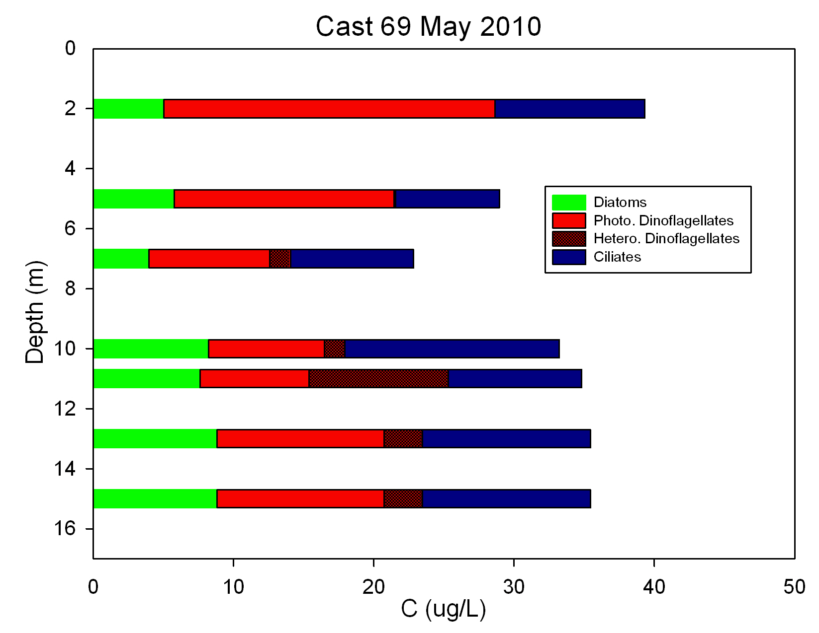
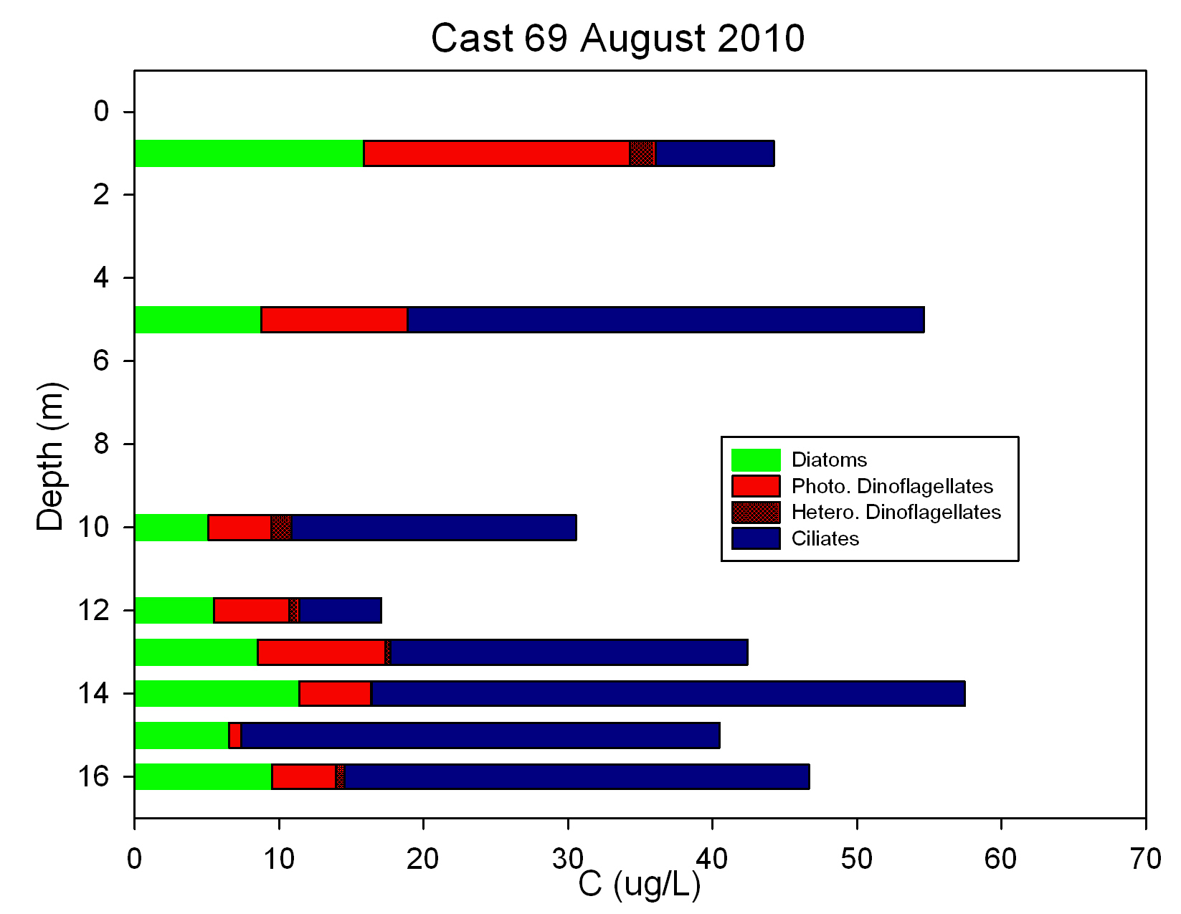
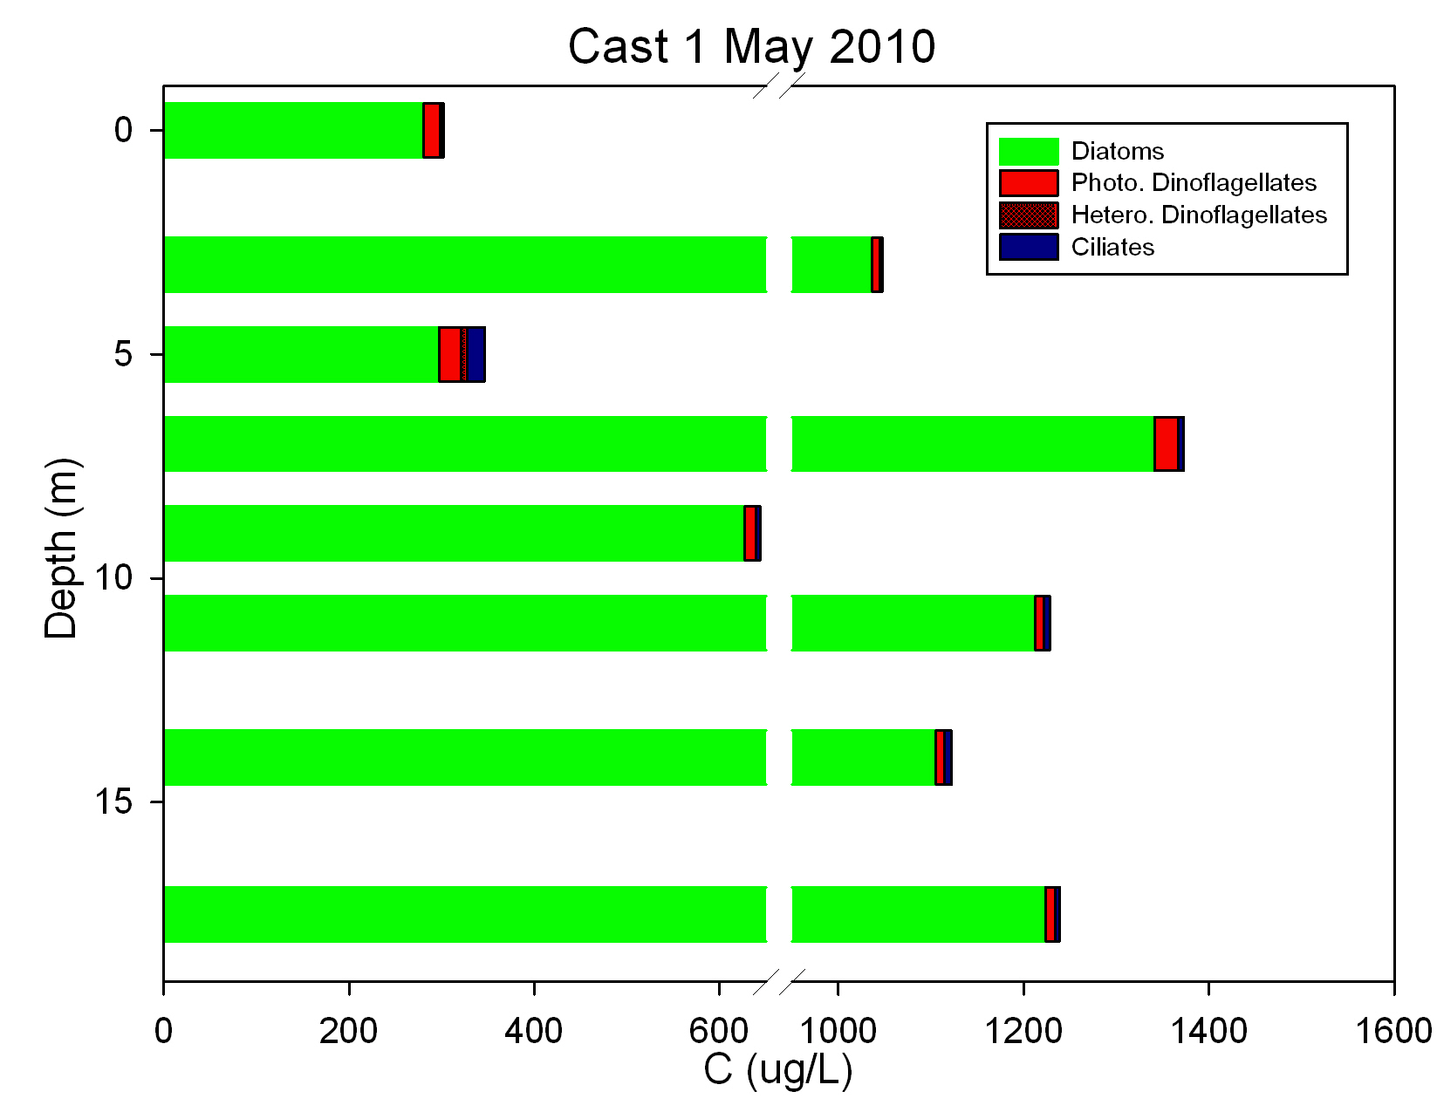
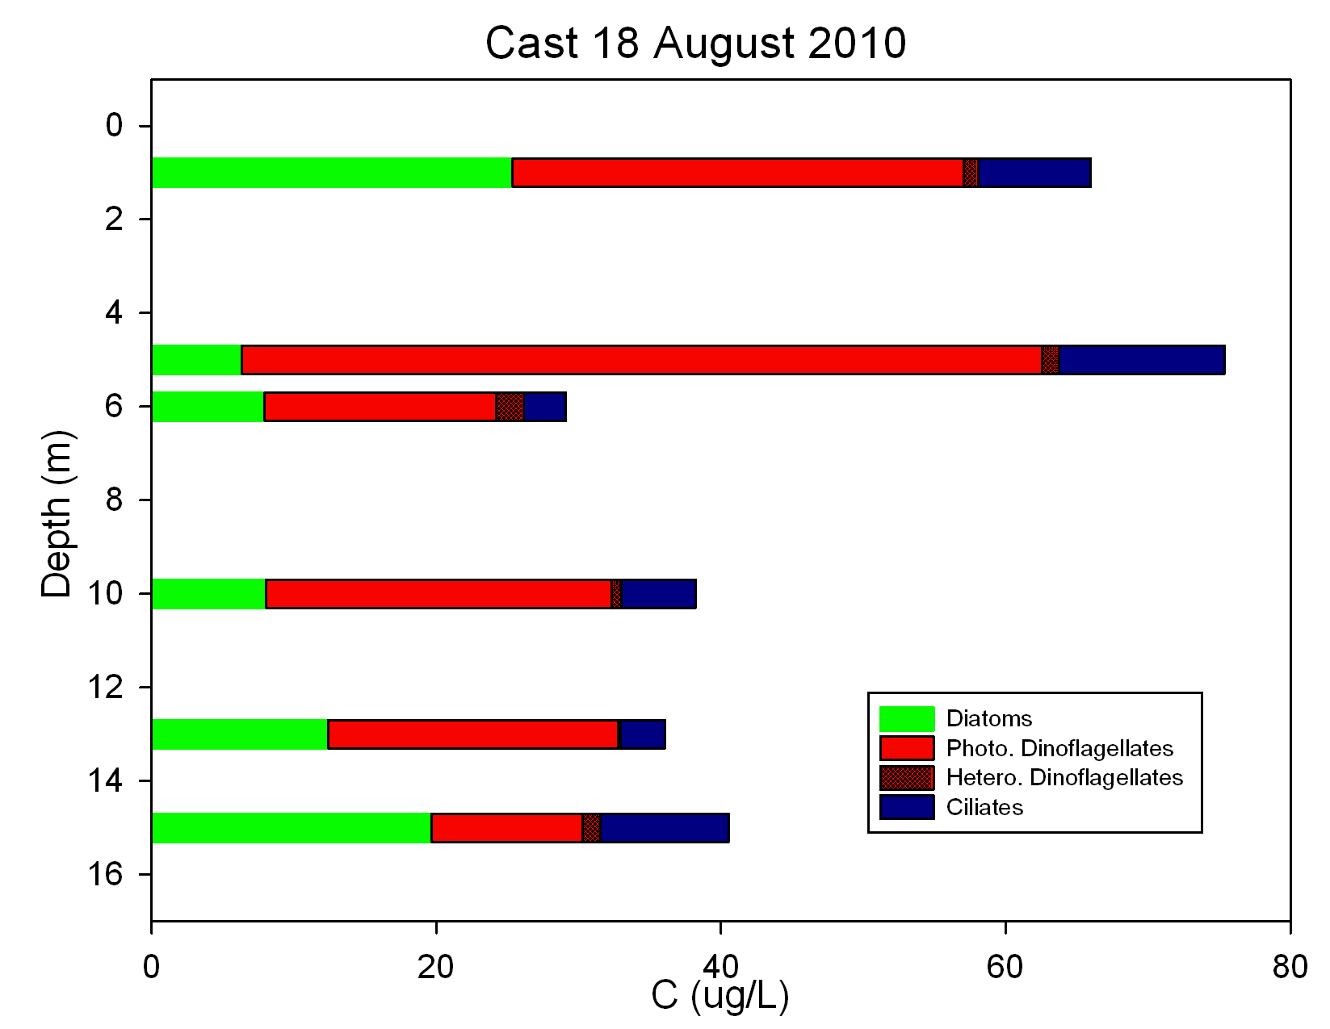
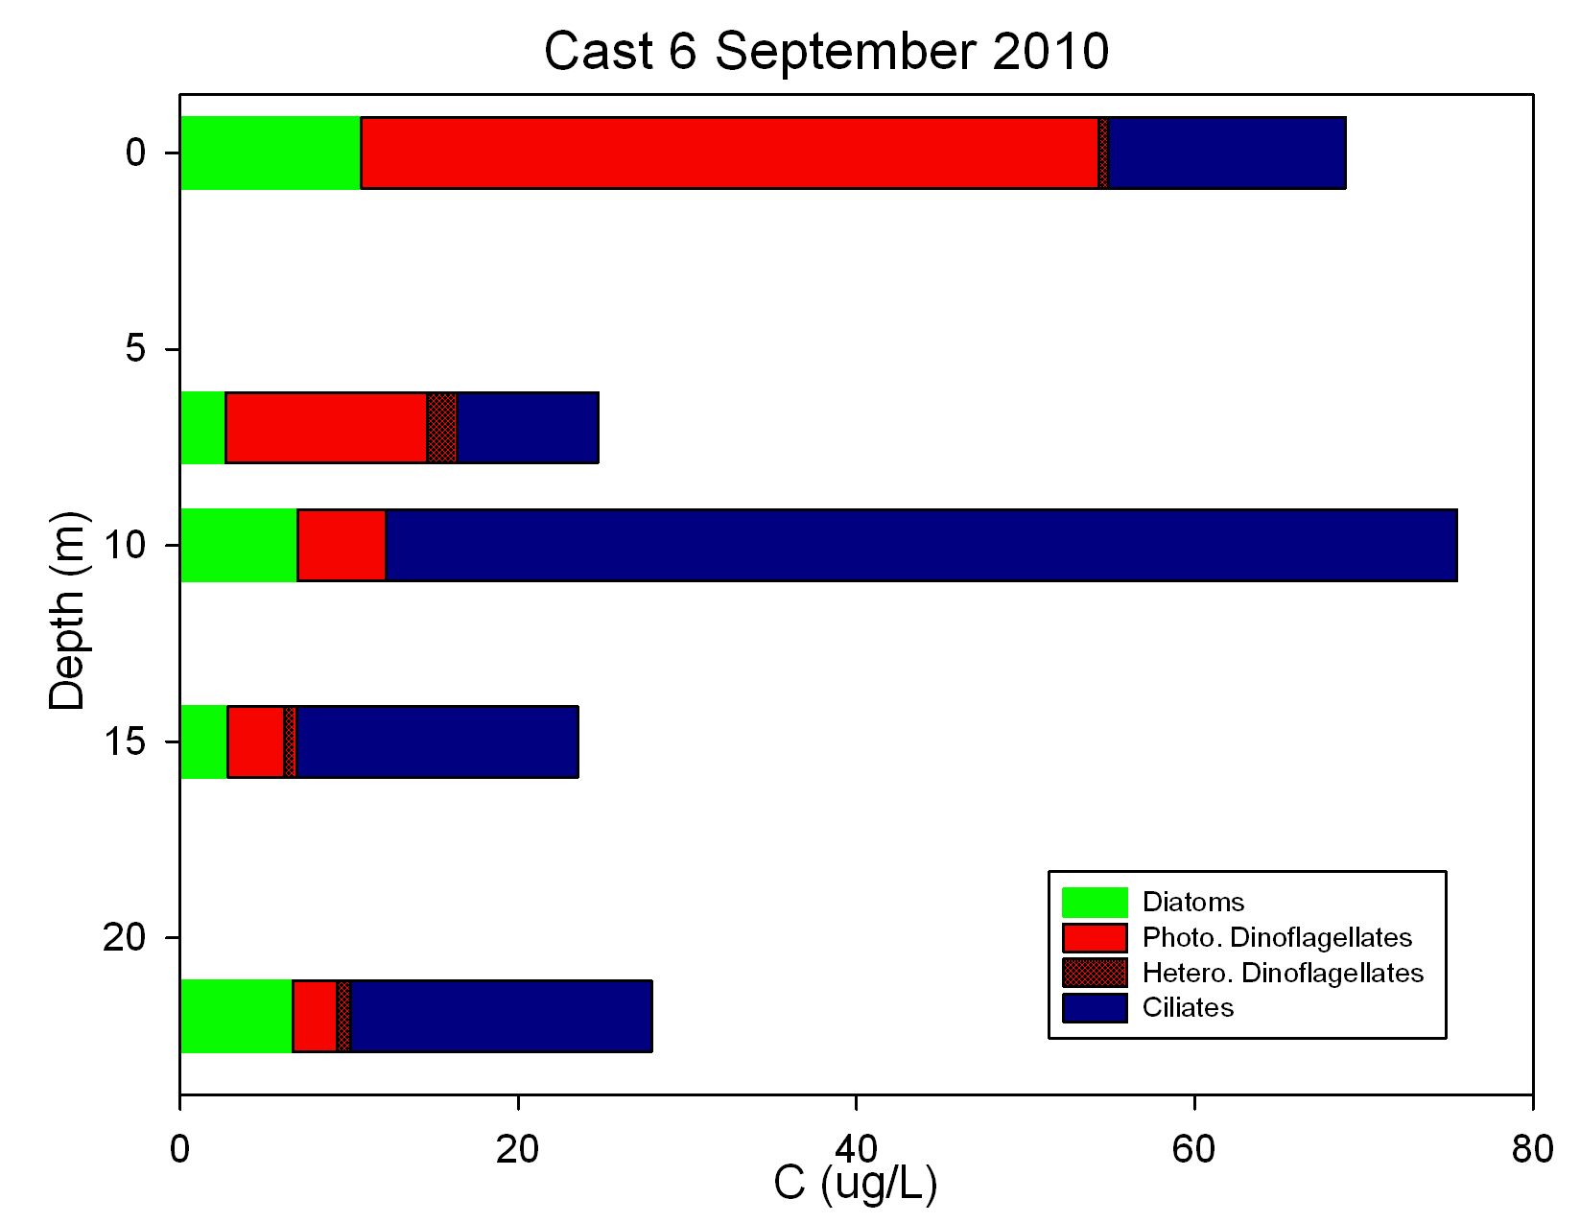
Seasonal Changes in Microplankton at North and South Stations, 2010
North
South
Most of the microplankton biomass can be heterotrophic dinoflagellates and ciliates, especially at North Station .
Contribution of Microzooplankton to Microplankton biomass increases from May to Sept.
Hypoxia can cause a bimodal distribution of microplankton biomass, with much of the biomass in the hypoxic lower layers and perhaps not available to copepods.
Estimates of microplankton availability to copepods as food depend on estimates of both phytoplankton and microzooplankton.

Slide 3
Seasonal Changes in Microplankton at North and South Stations, 2011
North
South
In hypoxic layers, most of the microplankton biomass in July was heterotrophic dinoflagellates and ciliates, especially at North Station .
Contribution of Microzooplankton to Microplankton biomass appears to increases under hypoxic conditions.
In May and July, most of the biomass was in the oxycline at the north station.
In Sept at North station, was the biomass of diatoms in low hypoxic waters due to siking of surface production?

Slide 4
Even in the more hypoxic year, 2012, a specialized “hypoxic” microzooplankton assemblage (such as observed in deep waters of the Baltic Sea) with relatively high biomass did not develop.
This may be because hypoxic events are transient in the Bay and anaerobic protists tend to grow slow (GGE’s about 25% of aerobic protists).
We often observed large dinoflagellates in bottom, hypoxic waters. Are they tolerant of low oxygen? Sulphide? Metabolically active or resting stages? Viable or non-viable?

Slide 5
Copepod grazing experiments at N and S station in surface waters, pycnocline/oxycline and bottom waters (Diane, Mike, Dave, Robert)
Grazing rates (clearnace and ingestion) based on chlorophyll very variable. Evidence for trophic cascades. Based on chl. data, can not compare grazing at N vs S or in normoxic or oxic waters.
Microplankton samples still being analyzed from 2011 experiments (should be complete in Jan 2013). Hopefully the data based on counts will allow comparison among N and S stations and normoxic vs. hypoxic layers.
Some caveats:
2011 data better than 2010 data because we got better at filling bottles without changing oxygen levels.
In some experiments at hypoxic stations, sulphide toxicity was probably a problem. Sampling may “drag” sulphidic water into upper hypoxic or normoxic layers.

